Slide 1
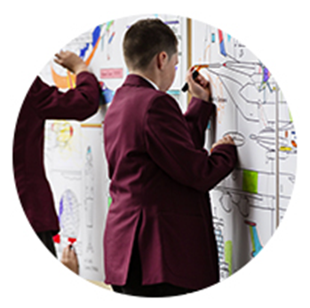
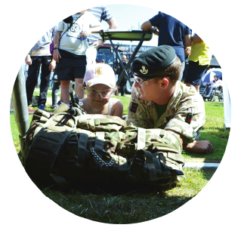
Supporting Children of Armed Forces families in Wales
SSCE Cymru Tool 8. Presentation: Armed Forces and experiences of Service children
Notes:
***Trainer notes have been added for each slide to support the delivery of the presentation.
This presentation has been developed by SSCE Cymru to inform educators, school leaders, governors, teachers, learning support assistants, school administration staff, staff working in school in other posts and other members of the school community of the experiences and challenges that Service children face as a group of learners in Wales.
The presentation can also be cut down to slides 1, 3, 5, 7-17, 19-20, 22, 25-26, 28-30 (slides that have a green circle in the top right corner) to be shown in school assemblies to help other pupils understand the experiences of Service children. The presentation could also be broken down into sections and delivered over the course of a week or month as part of a wider project/awareness raising activity.

Slide 2
About this presentation
This purpose of this presentation is to raise awareness of the experiences of Service children.
It has been produced alongside SSCE Cymru stakeholders, including schools, Armed Forces networks and charities and education professionals.
It draws on the experiences and challenges of Service children and families in Wales and uses examples of best practice and lessons learnt across different settings to support the needs of Service children in education.
Notes:
This presentation has been designed to last around 1 hour but can be adapted/reduced as appropriate based on the audience.
Discussion and questions are given time throughout the presentation - if you have longer this could be extended.
***Before delivering this presentation, the relevant information will need to be added to slides 7, 18, 21, 23, 26, 28-30.
Be aware of who the area Armed Forces Liaison Officer/Armed Forces Champion/Unit Welfare Officer is (if applicable) - they may wish to attend the presentation to support the delivery.

Slide 3
Definition of a “Service child”
A person whose parent, or primary carer, serves in the regular armed forces, or as a reservist, or has done at any point during the first 25 years of that person’s life.
Notes:
This is the SSCE Cymru definition – others may vary.

Slide 4
Discussion task
Identify what knowledge and awareness the group already has.
1. Identify those that are part of the Armed Forces community?
Are/were you a Service child?
Are you a veteran/ex-Service personnel?
Are you a Reservist?
Is your spouse/partner in the Armed Forces?
Is/was a member of your family in the Armed Forces?
Do you work with or have an involvement in supporting Service children?
2. In groups of 3/4
Discuss and record on large sheets what your group already knows about Service families and children and the experiences/challenges they may have (5 minutes).
3. Whole group feedback
Each group to share one of their key discussion items with the larger group.
Notes:
2. This activity could be carried out by asking people to stand up if they can answer yes to any of the questions. By the last question, it is likely that everyone will be standing.

Slide 5
Service children experiences film
https://vimeo.com/359754759
Notes:
Watch the film

Slide 6
Discussion task
1. In your small groups, discuss…
What were your first impressions of the film?
Was there anything that surprised you?
What have you learnt?
2. Record the discussion items
In groups, list five things that were most significant from the film.
3. Whole group feedback
Each group to share one of their key discussion items with the larger group.

Slide 7
Service children at (enter school name)
Our school has (insert number) Service children enrolled which is (insert percentage) of pupils.
There are around 2000 Service children in total in 400 schools in Wales.
Service children can be difficult to identify as there is currently no statutory requirement for schools and local authorities to capture this information in Wales.
Things to consider:
How your school collects data on Service children?
How is this information used to monitor and support this group of learners?
What can the school do to improve identification of Service children?
Notes:
Additional information: In the Welsh Government Armed Forces Covenant Annual Report 2019, Kirsty Williams AM, Minister for Education, made the commitment to collecting data on Service children in Wales.

Slide 8
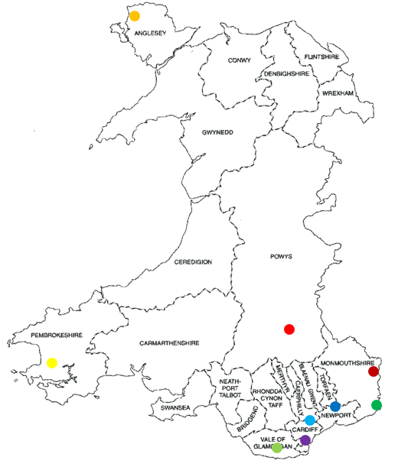
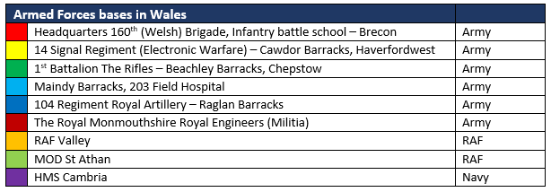
Armed Forces in Wales
Service personnel from all three Services are based at different locations across Wales, and there are also Reservists and veterans/ex-Service personnel.

Slide 9
Tri-Service community
Royal Navy/Royal Marines
British Army
Royal Air Force (RAF)

Slide 10
Armed Forces terminology
Exercise | When Service personnel go away for a week or more for training
Assignment/Appointment/Posting | Personnel are sent to another Armed Forces location to serve with that unit
Deployment | To go away on an operational deployment without their families
Mobility | Moving/relocating based on operational needs
Accompanied Posting | Personnel are assigned to another unit and take their spouse/partner and family with them to that new location
Rest and Recovery (R&R) | Leave is given to personnel during their deployment/operational tour to allow for rest and recuperation
Post-Operational Tour Leave (POTL) | Leave is given to personnel on their return from an operational tour to allow for rest and recuperation
Veteran | Anyone who has served for at least one day in Her Majesty’s (HM) Armed Forces: (Regular or Reserve) or Merchant Mariners who have seen duty on legally defined Armed Forces operations.
Service Leaver | Is in transition out of the Armed Forces
Service Family Accommodations (SFA)/ Patch/ Quarters/Behind the wire | MOD provided housing for Service personnel and their families, which may be located within an Armed Forces unit or embedded in the local community
Civvie/Civilians | Non-Service personnel

Slide 11
Armed Forces Covenant
The Armed Forces Covenant is a promise by the nation to ensure that those who serve or who have served in the Armed Forces, and their families, are treated fairly.
Local authorities in Wales are committed to addressing and responding to the needs of the Armed Forces Community. All 22 Local authorities in Wales have pledged their commitment to the Armed Forces Covenant.
Each authority has an Armed Forces Champion, which is a role undertaken by an elected member.
There is a network of Regional Armed Forces Covenant Liaison Officers (AFLOs) across Wales, whose role is to enable consistent delivery of the Armed Forces Covenant across Wales.

Slide 12
Service family experiences
May include:
Families posted without unit
Dual serving families
Single-parent families
Frequent home moves
Living abroad
Emotional impact of deployment
Change in family dynamic when transitioning out of the Armed Forces.
For more information about the Armed forces in Wales and experiences of Service families, including Armed Forces ranks for all of the Services, see the Armed Forces in Wales section of the new SSCE Cymru School Toolkit.

Slide 13
Service children experiences
Service children can bring a diverse range of strengths and experiences to a school community and will have a variety of learning experiences from previous schools to share. Service children bring new dynamics to communities.
Experiences may include:
Emotional impact of separation during deployment/training
Frequent school and home moves
Missing curriculum content/duplicating curriculum content
Making friends
Adapting to different curriculums
Living in different countries
Learning Welsh for the first time
Speaking other languages
Experiencing new cultures
Learning new skills and sports
Missing friends and family
Impact on family lifestyle when parent/s transition out of the Armed Forces.

Slide 14
“The good things I like: you get around and get to see different places… the other good thing is making different friends and experiencing getting to know other people.” Service child
“I was born in Germany August 2010, 2011 Dad went to Canada, 2012 he went to Afghanistan, 2014 Falklands, 2016 back to Canada, 2016 August then we moved to Bulford, 2017 we moved to Brecon.”
Service child
“It’s ok talking over Skype and that but sometimes you just want a hug when Dad is away.” Service child
“Being part of the Army is like being part of a family, an enormous family that spans the length of the UK, parts of Germany and Afghanistan.” Service child

Slide 15
Challenges/barriers for Service children
Being part of a Service family can be an extremely rewarding and beneficial experience, but aspects of the Armed Forces lifestyle can have challenges that impact on a child’s education.
Challenges may include:
Frequent school and home moves
Separation from Service parent(s)
Changes to family dynamics
Learning to manage positive and negative emotions
Delayed support for Additional Learning Needs (ALN) due to requirements not being identified
Difficulties in making commitments to relationships with peers, adults and school
Staff in school not understanding the needs and possible challenges that a Service child may face
Support for mental health and wellbeing
Living a long distance from extended family
Making new friends and moving on from previous ones
Keeping in contact with family/friends
Settling and joining in new activities.

Slide 16
Deployment experiences
Definition of deployment: periods when Service personnel are sent on operational service, either overseas or within the UK. A “tour” relates to the period of duty wherever a Service person is sent. This may be a tour at a defined Armed Forces establishment (a posting), an operational tour overseas or an extended period of training at an alternative location.
“You can’t stop yourself thinking about it, you can’t just say no I’m not thinking about it because he is your Dad, it’s hard to do that. I’ve grown up toing and froing from places and him not being at home all the time, I’m sort of used to it and I still miss him as much.” Georgia, Service child

Slide 17
Deployment cycle
Pre-deployment
Post tour
POTL
Deployment
Tour
Tour leave
End of tour
The deployment cycle of a parent going away on active duty will involve areas of this diagram. This will be the same for every Service but the length of time and experiences in each area can vary.
Notes:
Pre-deployment – The phase of preparation for departure and separation. This may last a few weeks or months depending on the length of notice given. Families will choose to deal with this in different ways, with some children being very aware of the upcoming deployment, and others being unaware.
Deployment – Preparing to deploy effects families in different ways, some children take it in their stride. Most children and adults are likely to feel sadness.
Tour – The length of time the serving family member is away on their deployment. Service children are likely to experience a mix of emotions during this time. Changes in behaviour can be an indicator of how they deal with these feelings in a variety of ways. It is likely that one or both parents being deployed will mean a change to the family/home dynamic, with roles and responsibilities being shifted.
Tour leave – Service personnel deployed for longer than four months will get some time off during their time away. This can add further reunion and separation issues for children and might also attract requests for term-time absence.
End of tour – The return from deployment is often a long awaited, exciting time of further change and can be challenging and stressful. Everyone in the family may have dealt with the separation in different ways. It is natural for those anticipating homecoming to have mixed emotions.
Post tour – Reunion is more than just a single event, it is a process of readjustment and like all processes, it may take some time. Another change in the family dynamics can cause confusion. The Service personnel returning from deployment may have been affected in a negative way which could therefore impact the rest of the family.
Post-Operational Tour Leave (POTL) – Normally a period of Rest and Recovery (R&R) is granted to each serving member who has been deployed, although this depends on the length of the tour and the military requirements. It is not uncommon for Service families to request term-time absence for their children during this time.

Slide 18
Support during deployment
During times of deployment (enter school name) supports it’s Service children by…
ACTIVITY: discuss ideas and ways to support Service children during deployment. *See the SSCE Cymru Tool 1. CHECKLIST: School actions and activities for suggestions. Then enter details of what the school does here.

Slide 19
Mobility experiences
Definition of mobility: moving/relocating based on operational needs.
“I’ve been to seven different schools. I’ve not stayed put in one school long enough. I think it is a big impact because you’ve just got to find time to make friends and settle in. It’s pretty hard but because you’ve done it lots you get used to it.” Service child
“I was in Episkopi School in Cyprus. It was very enjoyable! When my dad told me three or four weeks before we had to leave, it was very disappointing because I had the best time of my life there, I knew there was nothing I could do so I just got on with it.” Service child

Slide 20
Mobility
Relocating
Reconnecting
Settled period
Disconnecting phase
Service personnel can be required to move to different locations (postings) many times throughout their career.
These moves can be planned or occur at short notice, but ultimately can have significant implications for Service children, who may change schools many times during their school career.
Some families will move within the UK and possibly overseas.
Notes:
Settled period: when a family have been in a place for a while, they usually feel settled, secure and involved. They know the area, have friends and take part in activities locally. They may feel like they belong to the local community. As soon as they hear they are posted they will begin a process of disconnecting from their current location.
Disconnecting phase: this is usually characterised by spending more time and energy thinking about where one is going than where is at present.
Relocating: transition takes place between Armed Forces units upon assignment. The time of the actual move may feel like chaos as almost everything in a family’s life changes. Normal routines are disrupted, and this can feel very unsettling.
Reconnecting: when arriving at a new location, Service families will be busy meeting new people and settling into the new community. Service families can feel a mix of positive and negative emotions.

Slide 21
Support during mobility
During times of mobility (enter school name) supports it’s Service children by…
Before moving:
During move:
After move:
ACTIVITY: discuss ideas and ways to support Service children during mobility. *See the SSCE Cymru Tool 6. CHECKLIST: Transition in and out of school for suggestions. Then enter details of what the school does here.

Slide 22
Transition experiences
Definition of transition: period of time at which a move is made from civilian life to Armed Forces life and vice versa.
“He signed off last week, so he will be done by the end of this year. He’s done 24 years. I find that better because he will be around a lot. He likes watching us playing rugby, so he will get to see us more.”
Service child
Service personnel will all inevitably return to civilian life, whether at the end of their formal engagement or prematurely due to family obligations, health reasons or unforeseen circumstances. Leaving the Service and returning to civilian society can be stressful. The MOD encourages early planning for transition, in order to support the Service personnel and their family in the best possible way.

Slide 23
Support during transition
During times of transition (enter school name) supports it’s Service children by…
Before transition:
After transition:
ACTIVITY: discuss ideas and ways to support Service children during transition. *See the SSCE Cymru Tool 1. CHECKLIST: School actions and activities for suggestions. Then enter details of what the school does here.

Slide 24
Group activity
Use the following headings and in a group record your ideas on the types of challenges/barriers schools may face in supporting Service children.
1. Family
2. Learning readiness
3. Progress and attainment
See the Service children’s experiences section of the new SSCE Cymru School Toolkit for ideas of what these challenges may include.

Slide 25
Education in Wales
The mobile nature of an Armed Forces families lifestyle means Service children are likely to attend a number of schools in different countries and regions.
Ways this can affect their education may include:
Learning Welsh for the first time
Different types of schools across Wales
Different curriculums in Wales, England, Scotland and Ireland
MOD schools (schools based abroad for Service children) follow England’s curriculum
Different exam boards and qualifications
Different inspectors e.g. Estyn in Wales and Ofsted in England
Different terminology and support structure e.g. ALN in Wales and SEN in England
Different school age grouping and terminology.

Slide 26
(enter school name)’s role in supporting Service children
We have a moral duty as a nation and as educators to ensure that the families of those serving are not negatively impacted because of their commitments to the Armed Forces. There are many positive aspects about being a member of an Armed Forces family, yet many Service children suffer significantly in their education.
“Article 28: Your right to learn and go to school.”
United Nations Convention on the Rights of the Child
“Article 29: Your right to become the best that you can be.”
United Nations Convention on the Rights of the Child

Slide 27
Action plan task
Consider what actions the school could take to avoid disadvantage for Service children.
In a group work through and discuss the SSCE Cymru Tool 1. CHECKLIST: School actions and activities
Indicate who, what, how and when for each of the activities
Which will form the basis for a school development/action plan
3. Add any additional actions the school could take
4. Populate the next slide with some of the key items identified in the checklist.

Slide 28
(enter school name)’s activities to support Service children

Slide 29
Further support
If someone in your family is or was in the Armed Forces and you would like to speak about it, see:
Name (enter name)
Job title (enter job title)
Location (enter their location in the school)
There is lots of useful information on the Service children section of the SSCE Cymru website, including:
Films of Service children talking about their experiences
Information about living in Wales
Advice on learning Welsh
Suggested resources
Details of where to access support and advice.
WWW.SSCECymru.co.uk

Slide 30
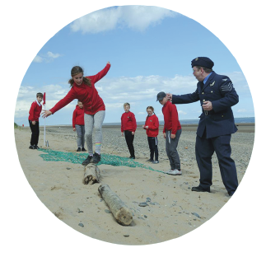
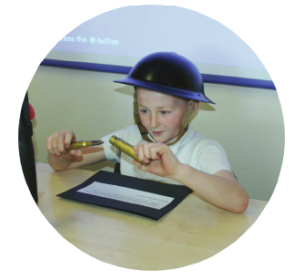
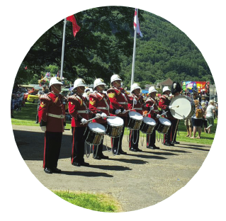
Questions?

